Slide 1


Lesson 1 English and me
STARTING UP

Slide 2

How do you feel about English? Open your notebook and write words you associate with the English language.

Slide 3
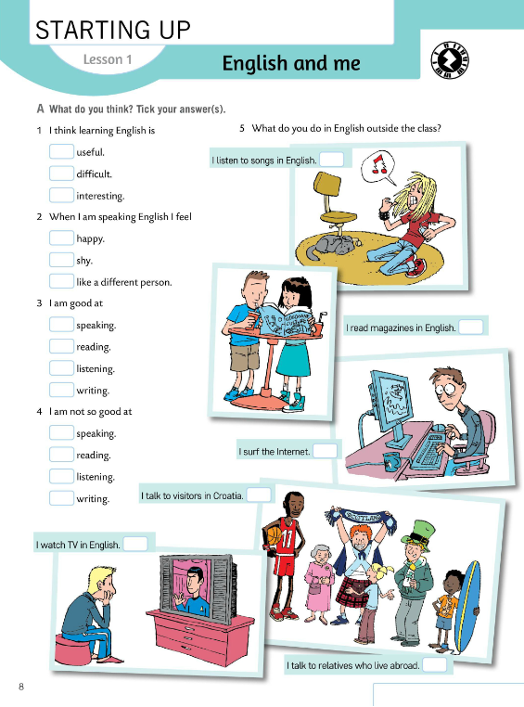
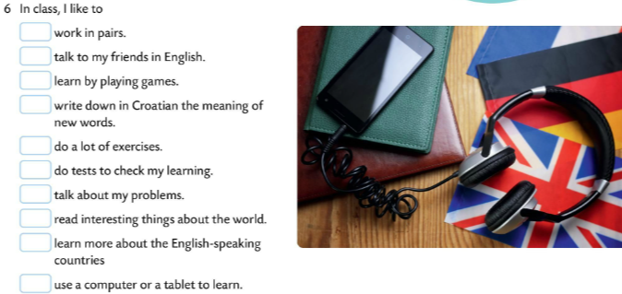
What do you think? Read the questions in Task A and put a tick in front of the answers that are true for you.
useful – koristan
difficult – težak
shy – sramežljiv
like a different person – poput druge osobe
work in pairs – rad u paru
write down in Croatian the meaning of new words – zapisati na hrvatskom jeziku značenje novih riječi
do a lot of exercises - puno vježbati
do tests to check my learning – provjeriti naučeno rješavanjem provjera znanja

Slide 4
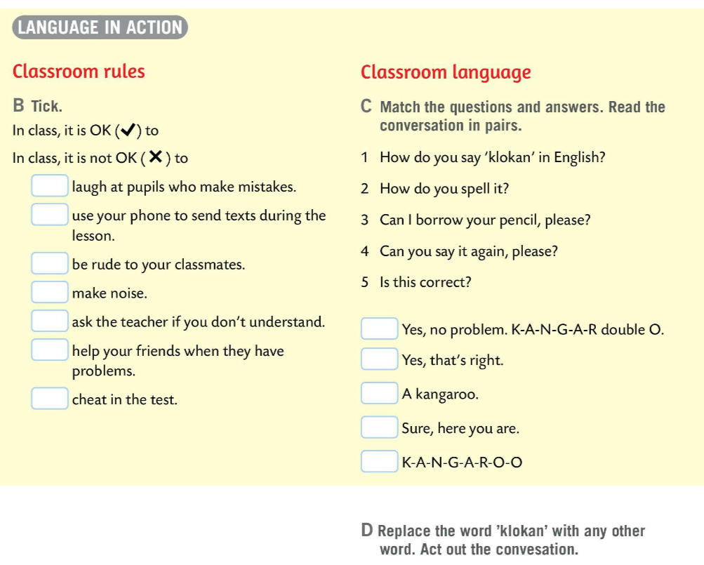
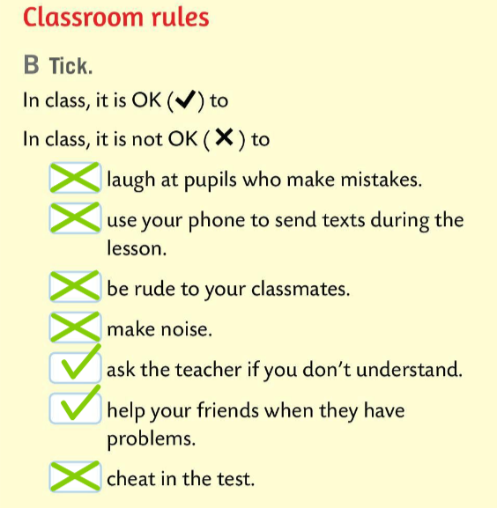
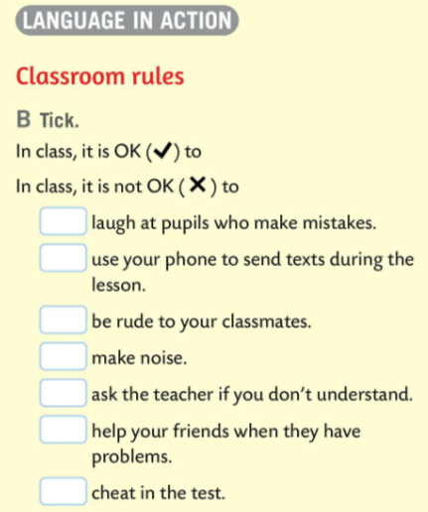
Look at the list of the classroom rules in Task B.
Put a tick in front of the sentences that describe what is OK to do in class.
Put a cross in front of the sentences that describe what is not OK to do in class.
smijati se učenicima koji griješe
koristiti mobitel za slanje poruka tijekom sata
biti zločest prema prijateljima iz razreda
bučiti
pitati učitelja za pomoć ako nešto ne razumiješ
pomoći prijateljima kada imaju poteškoća
varati na ispitu
Check.

Slide 5
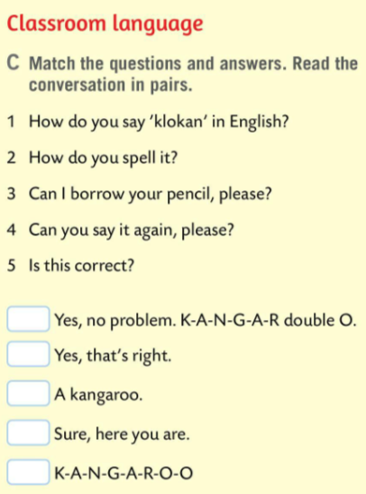
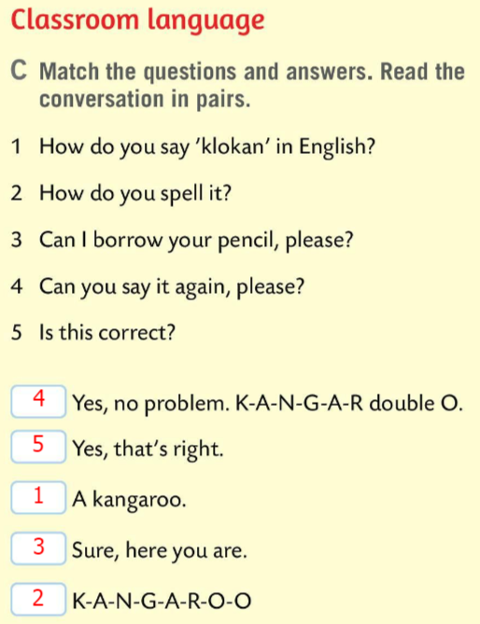
Match the questions and answers in Task C.
spell – slovkati
borrow – posuditi od koga što
Check.

Slide 6
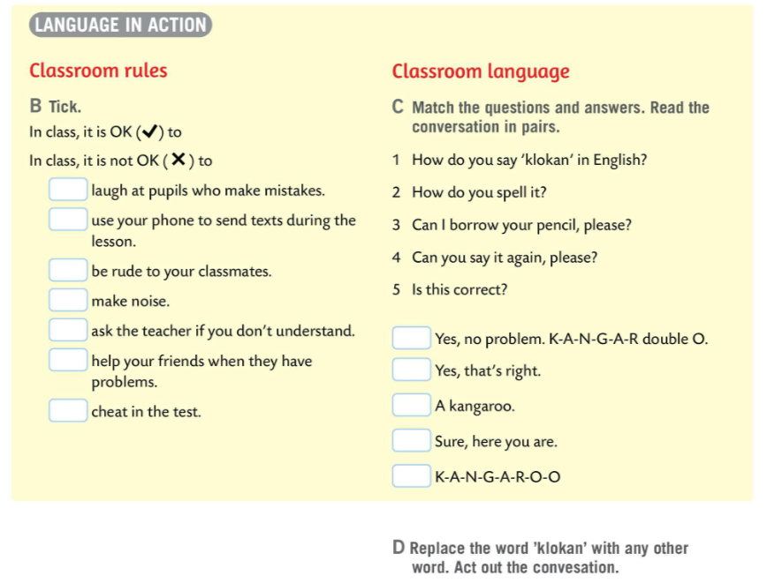
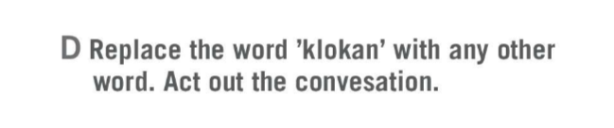
Act out the conversation in Task D and replace the word ‘klokan’ with any other word.

Slide 7
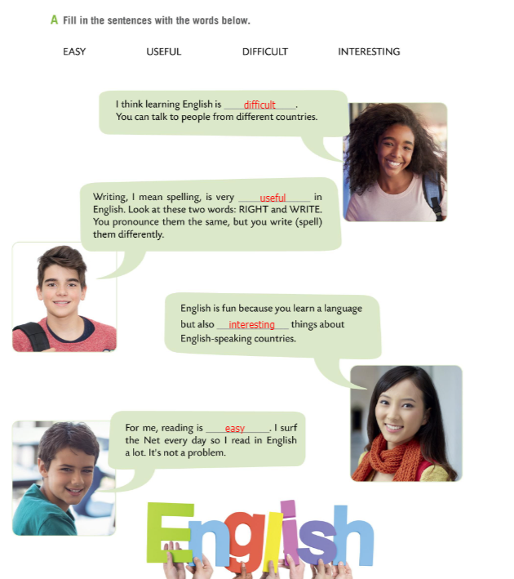
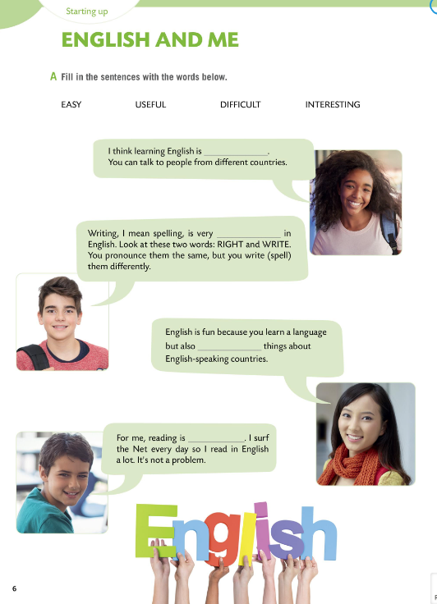

Workbook, page 6.
Fill in the sentences with the words given in Task A.

Slide 8
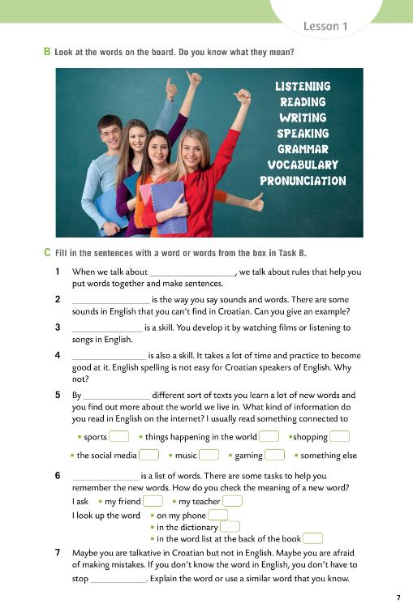
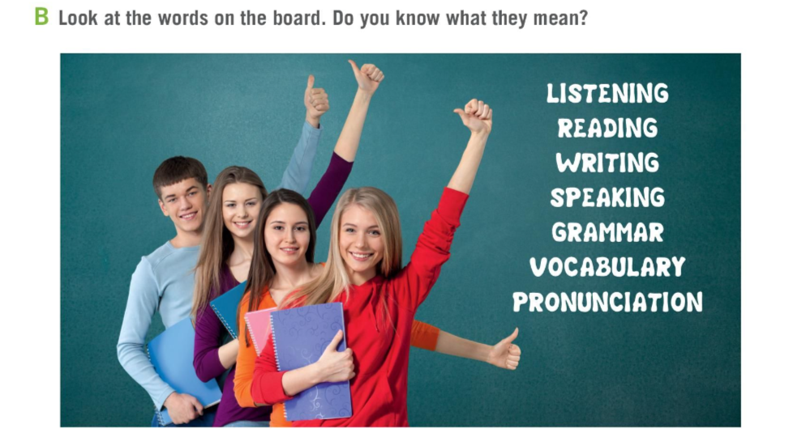
Workbook, page 7

Slide 9
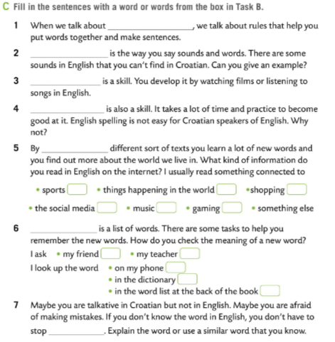
Workbook, page 7
Fill in the sentences in Task C with a word or words from the box in Task B.
grammar
Pronunciation
Listening
Check.
Writing
reading
Vocabulary
speaking

Slide 10
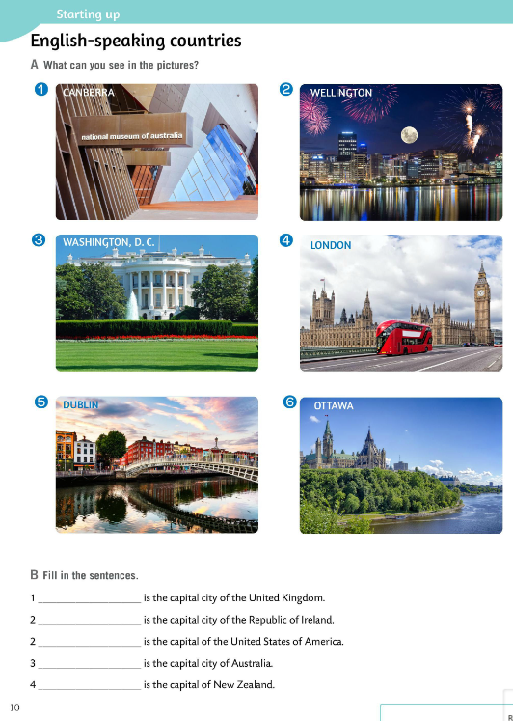
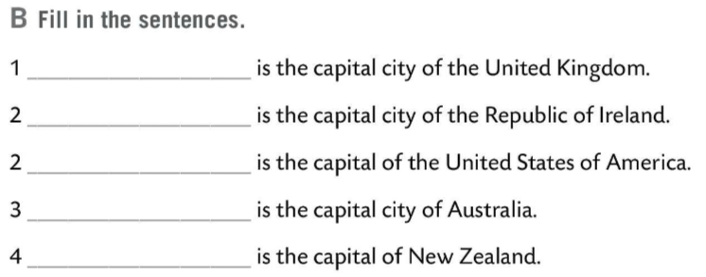
What can you see in the pictures in Task A?
Capital cities.
Do Task B. Fill in the sentences. What are the capital cities of these countries?
Check.
London
Dublin
Washington D.C.
Canberra
Wellington

Slide 11
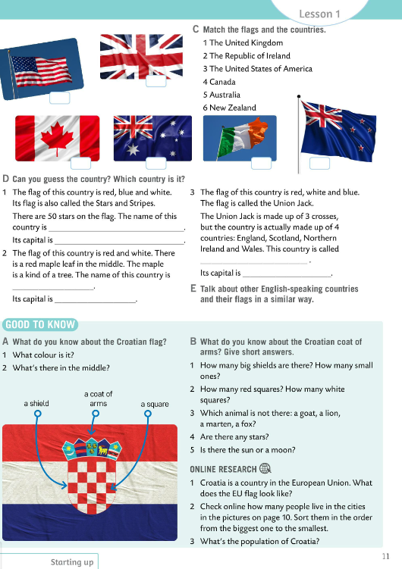
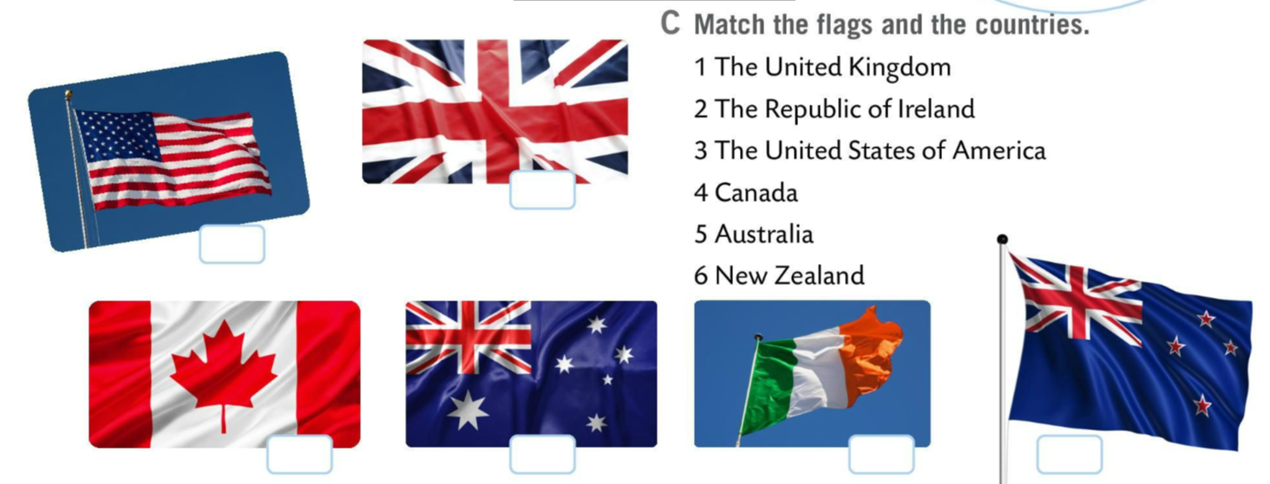
Match the flags and the countries in Task C.
Check.
1
3
4
5
2
6

Slide 12
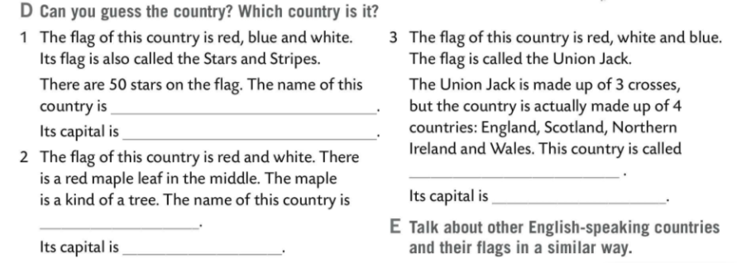
Read the descriptions in Task D and guess the country.
Check.
The United States of America
Washington D.C.
The United Kingdom
London
Canada
Ottawa

Slide 13
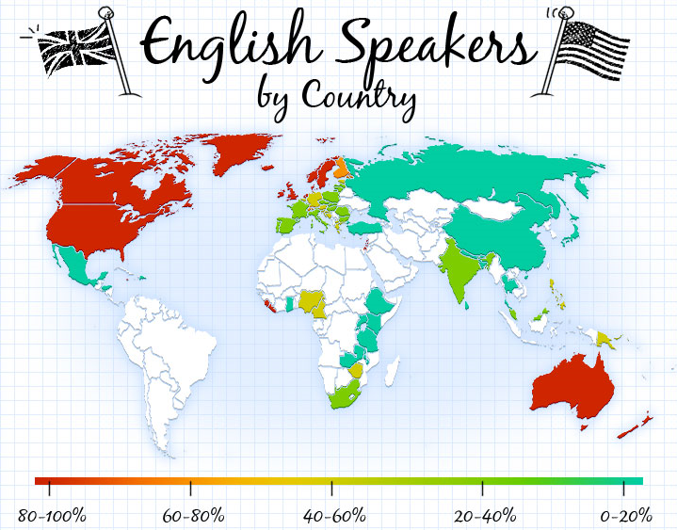
Talk about other English speaking countries and their flags in a similar way.

Slide 14
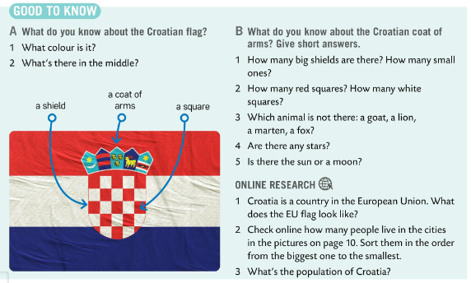
Look at the GOOD TO KNOW box and answer questions in Task A. What do you know about the Croatian flag?
Check.
Task A 1 It’s a tricolour of red, white and blue.
2 In the middle there is a shield and the Croatian Coat of Arms.

Slide 15
What do you know about the Croatian Coat of Arms? Slove Task B and write short answers in your notebook.
Check.
Task B
1 There is one big shield and five small shields.
2 There are 13 red squares and 12 white squares.
3 A fox is not on the flag.
4 Yes, there are two six-pointed stars.
5 There is a moon.

Slide 16
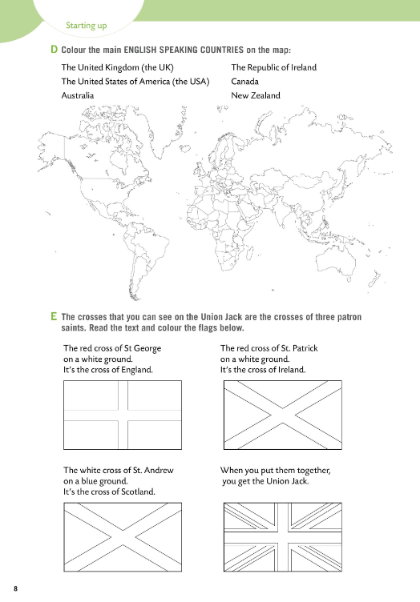
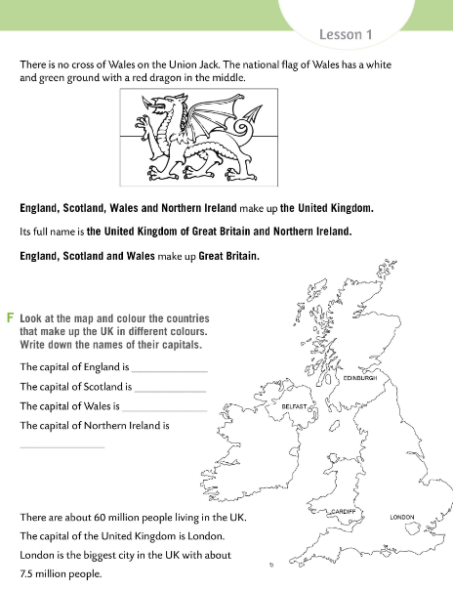
Workbook pages 8 and 9.
Homework: Task D, E, and F

